Slide 1

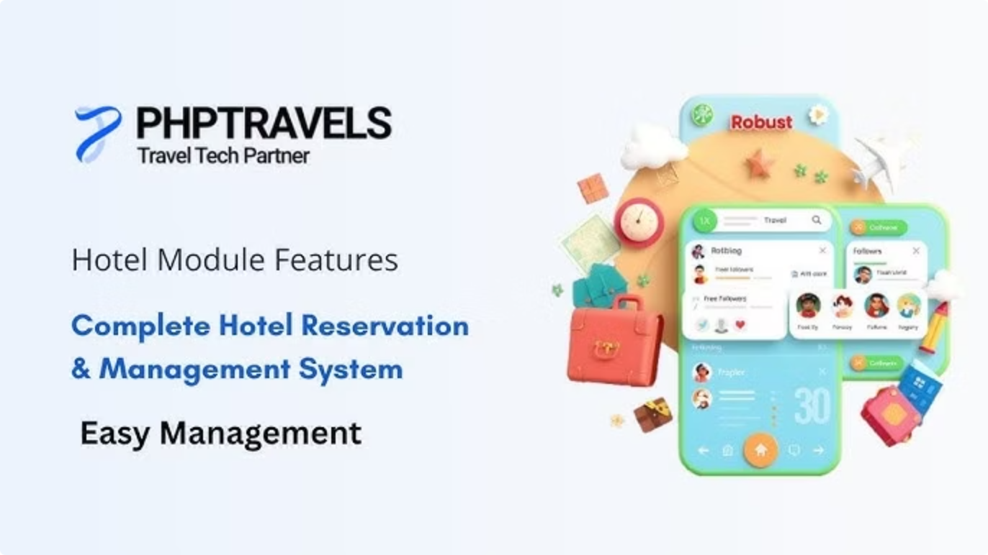
Automating PHPTravels
A Selenium, Java, TestNG & POM Success Story
Prepared BY:
Mohamed Galal El Sayed
Nayera Abdel Moniem
Heba Mohamed Ali
Ali Mohamed Ali

Slide 2
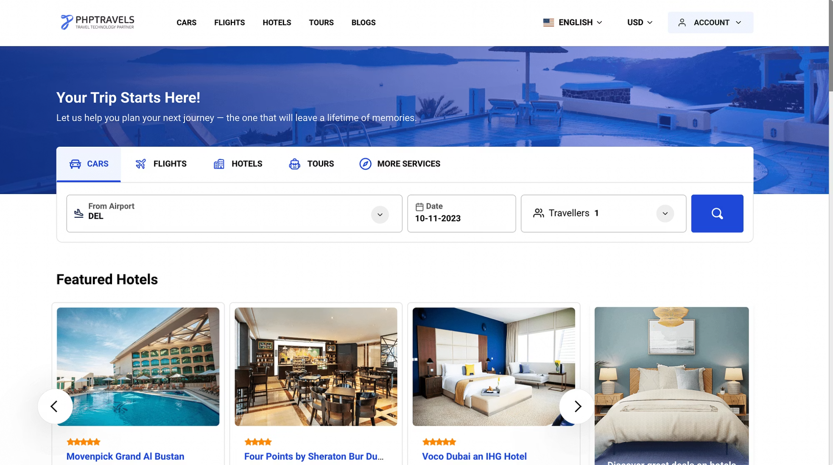

Project Overview
Automated end-to-end testing for PHPTravels Cars,Flights,Stays And Tour booking workflow
FLOW
What We Tested
Login.
Navigate to dashboard.
Car Rent Model.
Book Flights Model.
Book Stays Model.
Book Tours Model.
Java + Selenium WebDriver
TestNG
Core automation engine
Test orchestration & reporting
Maven
Page Object Model
Dependency & build management
Clean, reusable architecture

Slide 3

Framework Structure
Base Tests
WebDriver setup.
Browser initialization.
Link for PHP Travels Website.
Before and After Method Actions.
1
Pages Packages and Classes For Pages
2
Page Object Model implementation.
Reusable Code and Functions.
Test Cases
3
Business flow execution.

Slide 4
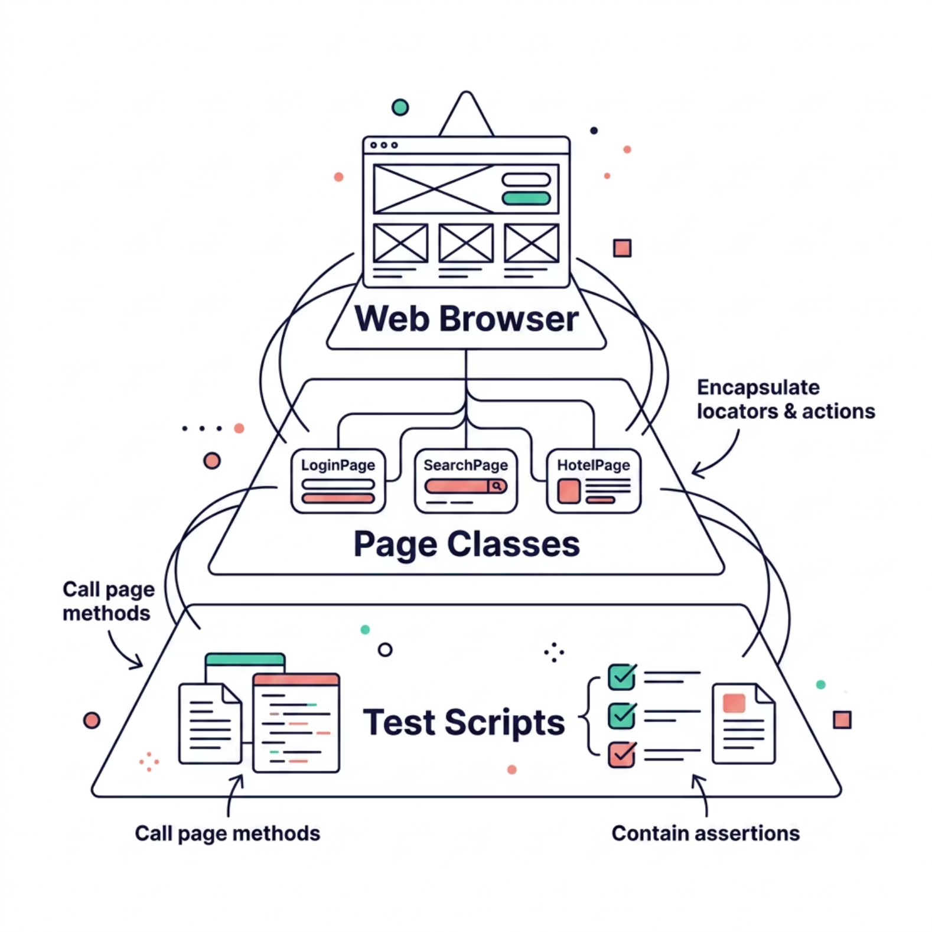

The Page Object Model in Action
How POM Works
Each page of PHPTravels — Login, Search, Hotel Details — gets its own dedicated Java class. These classes encapsulate all locators and user interactions, keeping test scripts clean and readable.

Slide 5
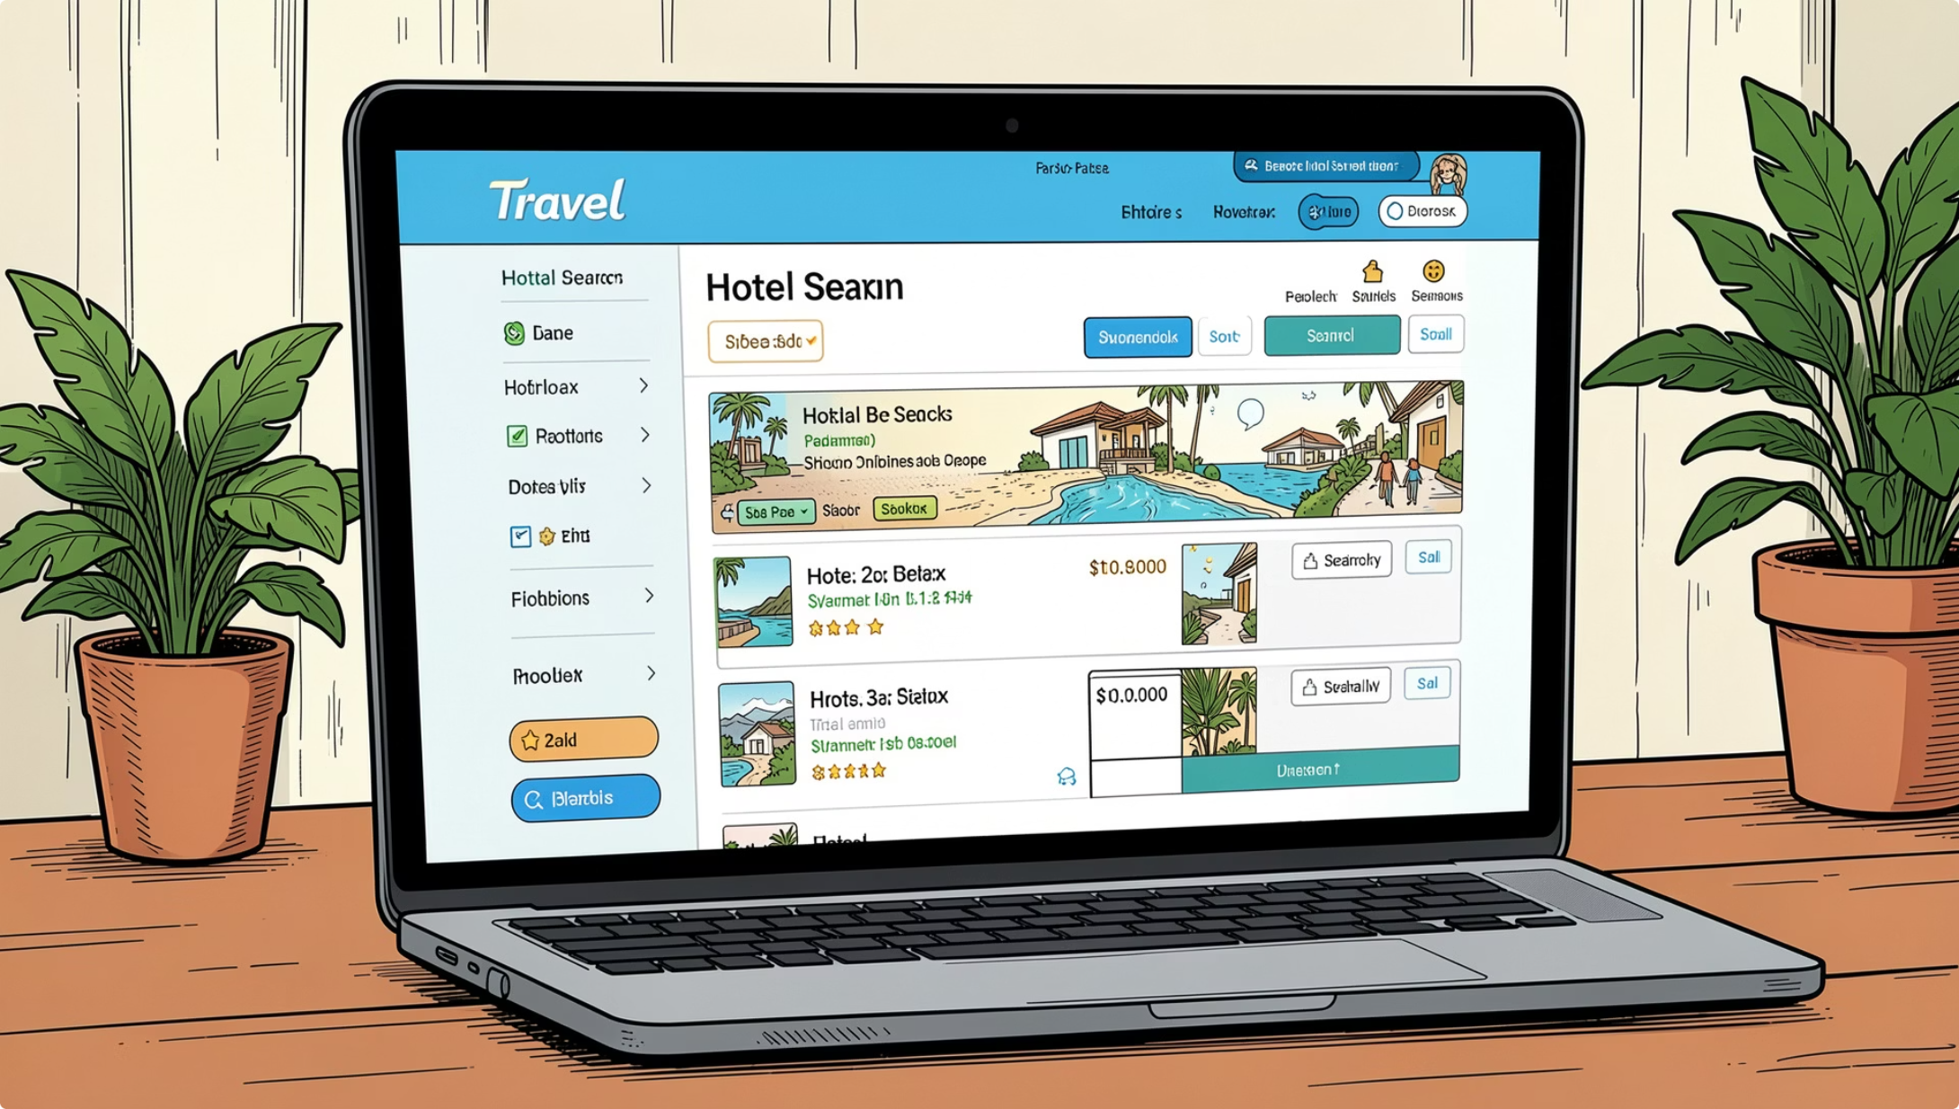
Key Test Scenarios Implemented
User Authentication
Login using demo credentials (user@phptravels.com / demouser).
Search Functionality
Searching for Hotels, Flights, Cars and Tours with various filter combinations.
Booking
End-to-end booking flow

Slide 6
Why This Stack?
Java
Selenium WebDriver
Widely adopted, object-oriented language with a massive community and rich ecosystem of libraries.
Industry-standard browser automation with native cross-browser support — Chrome, Firefox, and beyond.
TestNG
Page Object Model
Powerful test configuration, flexible execution, parallel runs, and built-in HTML reporting.
Separates UI locators from test logic, reducing redundancy and simplifying maintenance.

Slide 7

Thank You.
We appreciate your time and interest.

